Slide 1
RDA and Authority Processing
Highlights of 2014 Marcive Project
Dickinson College
Report by Kirk Doran

Slide 2
Abbreviations in description
Before

Slide 3
Abbreviations spelled out
After

Slide 4
Abbreviations in description
Before

Slide 5
Abbreviations spelled out
After

Slide 6
Abbreviations
Before
xxiv, 478 p. col. front., illus. (incl. maps) plates (part. col.) 24 cm.
After
xxiv, 478 pages : color frontispiece, illustrations (including maps) plates (part. color) ; 24 cm

Slide 7
Noli uti Latina
Before
After

Slide 8
Noli uti Latina
Before
After

Slide 9
Publishing roles

Slide 10
New RDA metadata
=336 \\$atext$btxt$2rdacontent
=337 \\$aunmediated$bn$2rdamedia
=338 \\$avolume$bnc$2rdacarrier
=336 \\$atext$btxt$2rdacontent
=337 \\$acomputer$bc$2rdamedia
=338 \\$aonline resource$bcr$2rdacarrier

Slide 11
New RDA metadata
=336 \\$atext$btxt$2rdacontent
=337 \\$aunmediated$bn$2rdamedia
=338 \\$avolume$bnc$2rdacarrier
=336 \\$atext$btxt$2rdacontent
=337 \\$acomputer$bc$2rdamedia
=338 \\$aonline resource$bcr$2rdacarrier

Slide 12
DVD example
=300 \\$a1 videodisc (88 min.) :$bsound, color ;$c4 3/4 in.
=336 \\$atwo-dimensional moving image$btdi$2rdacontent
=337 \\$avideo$bv$2rdamedia
=338 \\$avideodisc$bvd$2rdacarrier

Slide 13
Relator terms for people
Notes:
MARCIVE does not add Relator terms. However, sometimes the linked authority record can make the changes as described in this slide. Also, there are also profile options that expand abbreviations to certain relator terms, which would make the library’s database more consistent and RDA complaint.

Slide 14
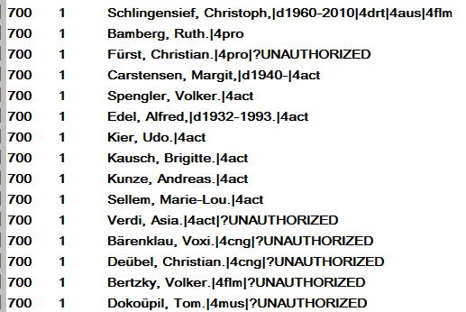
Relator codes (staff view)
Before
Notes:
Please see notes in slide 13.

Slide 15
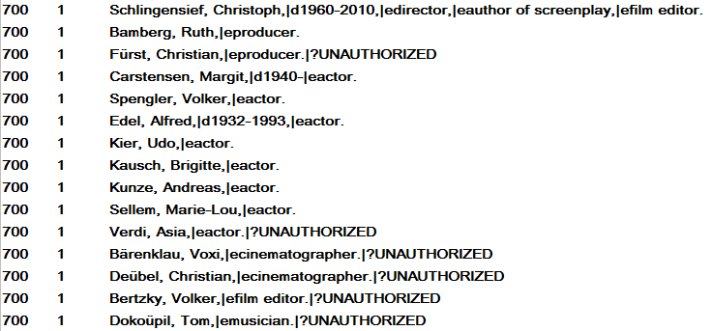
Relator terms (staff view)
After
Notes:
Please see notes in slide 13.

Slide 16
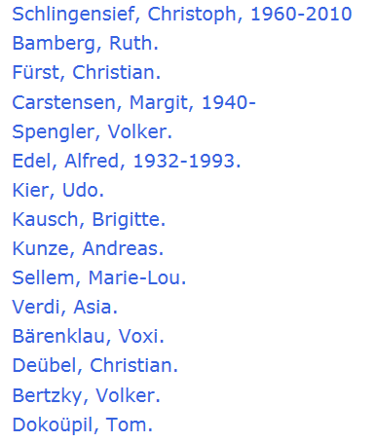
Relator codes not seen in OPAC
Before
Notes:
Please see notes in slide 13.

Slide 17
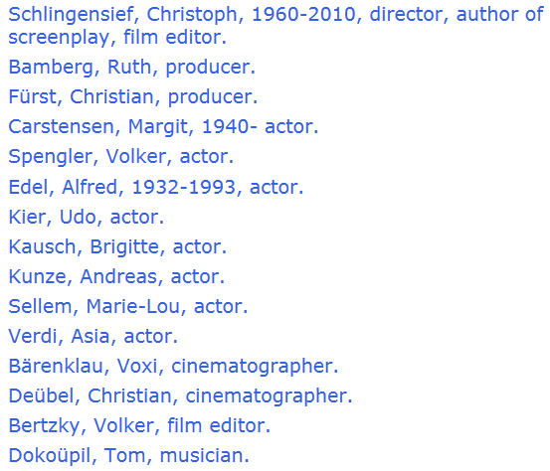
But relator terms are!
After
Notes:
Please see notes in slide 13.

Slide 18
Genre terms distinguished

Slide 19
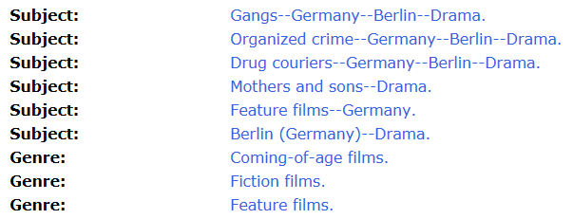
Genre terms distinguished

Slide 20
… authorized and consolidated.
Unauthorized forms of names ...

Slide 21
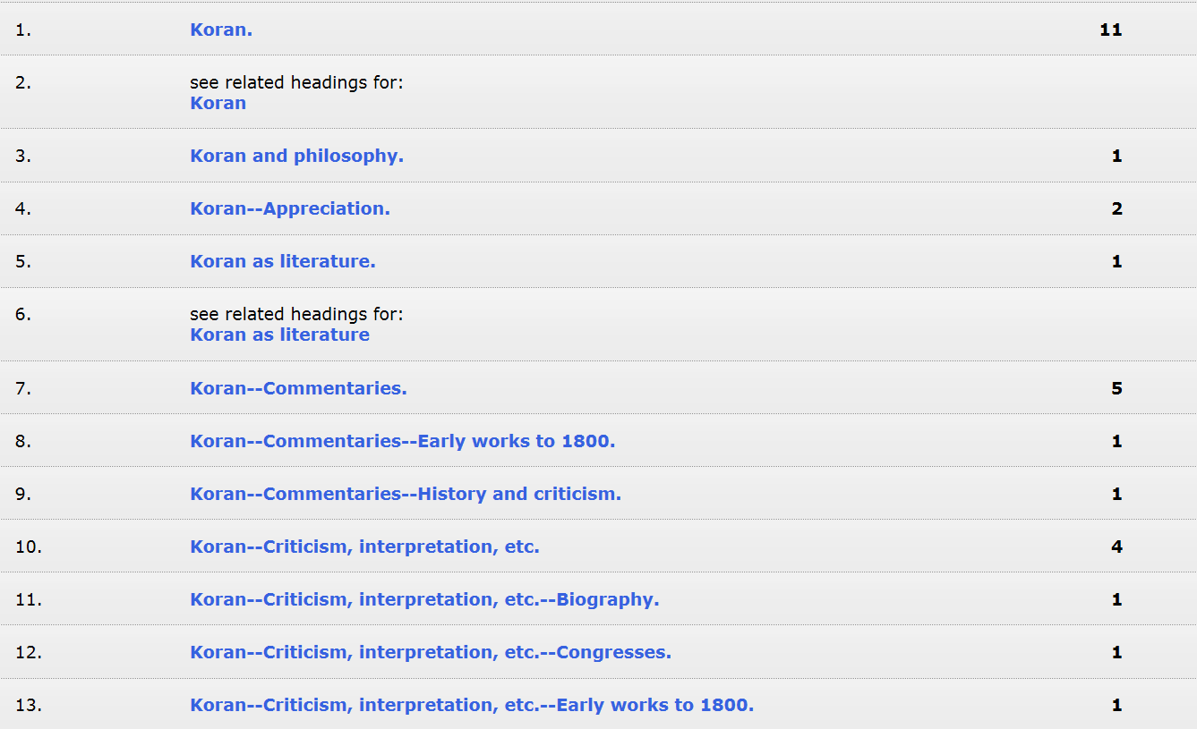
Obsolete subject headings …

Slide 22
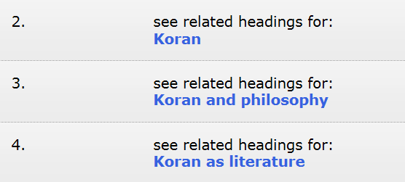
… changed to authorized form ...

Slide 23
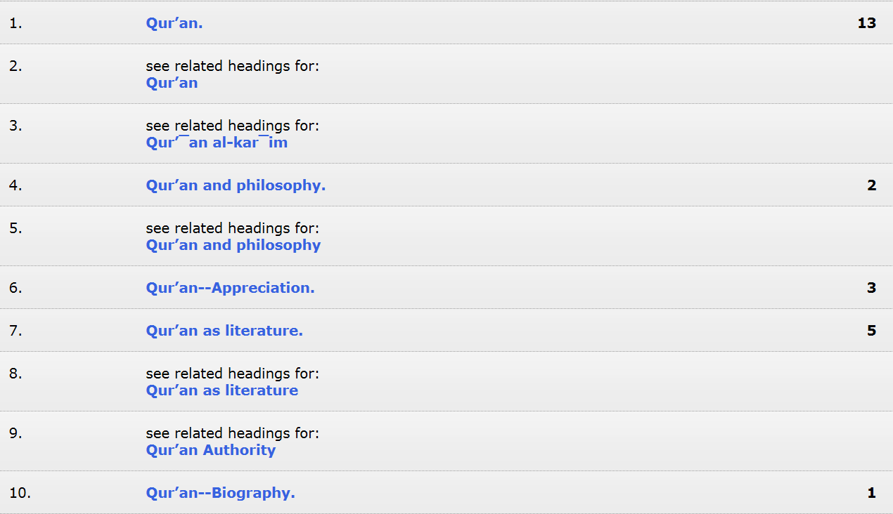
…of the current subject heading.

Slide 24
Obsolete subject headings …

Slide 25
… changed to authorized form ...
Cross references lead you to …

Slide 26
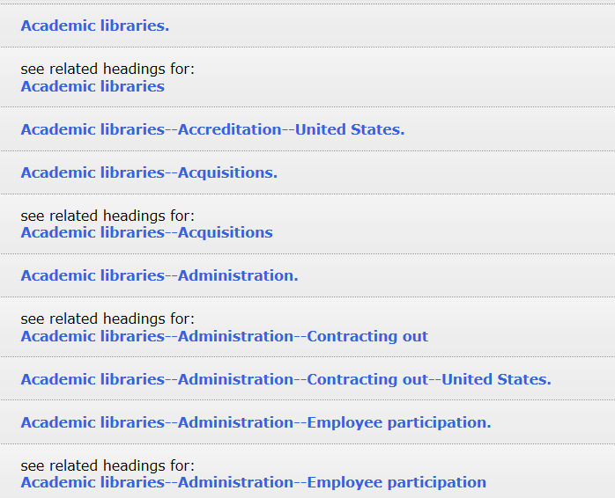
… the current subject heading.

Slide 27
Finis
End

